Slide 1
CPHC NCD Solution PHC
AYUSHMAN BHARAT

Slide 2
Aims of Ayushman Bharat Programme (NCD)
Sub-Centres would be upgraded to Health and Wellness Centers
To screen all men and women over 30 for Non Communicable diseases such as:
Hypertension
Diabetes
Cancers - Oral, breast & cervical
To bring Health workers, Doctors and Government officials onto a single integrated platform

Slide 3
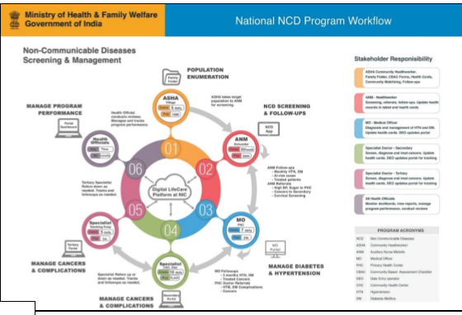
NCD Program Workflow

Slide 4
Waterfall flow for NCD program
NCD
ASHA Workers
ANM’s
Medical Officers (PHC)
Specialist (CHC)
Specialist at Tertiary Health care (DH)
Health Official
Conclusion of Results

Slide 5
ASHA Filling up family/household folder
By estimating population to be screened & enumeration of adults 30 years and above during routine household visits
Records information manually:
Task 1. Completing CBAC - Community Based Assessment Checklist
Task 2. Health cards
Task 3. Maintaining village register/ family folder
Task 4. Identifying population with risk or no risk factors

Slide 6
ANM Support & Manage
Task 1. Support the ASHA through the field visits
Task 2. Cross verify at least 10% population and also you will undertake enumeration in some areas where ASHA’s position is vacant
Task 3. Provides logistics to ASHA workers

Slide 7
Medical officers - MO
Task 1. Support & manage the maintenance of records and reports on portal
Staff Nurse
Pharmacist
Counsellors
lab technician
ANM
ASHA
Task 2. Raise awareness on risk factors of NCDs, healthy lifestyle, benefits of screening and social protection schemes and other treatment options that would cover the costs of care, through platforms
Task 3. Ensure timely follow up.
Task 4. Referral to specialist for severe and critical conditions

Slide 8
Patient Enrolment –Form – Medical Officer/PHC
ID Information
Family Folder Details
Individual Information
Address Information

Slide 9
Flow at PHC Level
Enrolment Form
Enrolment
Search

Slide 10
